Slide 1
SHARAD INSTITUTE OF TECHNOLOGY COLLEGE OF ENGINEERING ,YADRAV
ADVANCED JAVA PROGRAMMING
Presented By : Mr. PRASHANT B.PATIL
DEPARTMENT OF COMPUTER & SCIENCE ENGINEERING

Slide 2
SYLLABUS
Unit 1: Abstract Windowing Toolkit
Unit 2 : Swings
Unit 3 : Event Handling
Unit 4: Networking Basics
Unit 5 : Interacting With Database
Unit 6 : Servlets

Slide 3
Introduction to Advanced Java :
Advanced java is the next level of core java.
Core java covers the fundamental concepts in the java programming language.
ADJ is nothing but web and enterprise application which basically follows client and server architecture.
ADJ covers more advanced concepts such as web technologies and database accessing.

Slide 4
So,
Core java – to build general application
ADJ – to build enterprise level application

Slide 5
UNIT 1
ABSTRACT WINDOWING TOOLKIT

Slide 6
AWT stands for Abstract Window Toolkit.
AWT is collection of classes and interfaces.
AWT package contains large number of classes which help to include various graphical components in the java program.
AWT provides a platform-independent and device-independent interface to develop graphic programs that runs on all platforms, including Windows, Mac OS X, and Unixes.

Slide 7
Only 2 packages - java.awt and java.awt.event are commonly-used.
1. The java.awt package contains the core AWT graphics classes:
GUI Component classes.
GUI Container classes.
Layout managers.
Custom graphics classes.
2. The java.awt.event package supports event handling:
Event classes.
Event Listener Interfaces.
Event Listener Adapter classes.

Slide 8
1.1. Component, Container, Window, Frame and Panel
Component
Container
Panel
Window
Frame
Canvas

Slide 9
Component :
Component is the super class of all graphical classes from which variety of graphical classes can be derived.
Methods :
void setLocation( int x_position, int y_position)
void setSize( int width, int height)
void setBound( int x_position, int y_position,
int widtth, int heght)

Slide 10
Container :
Container is a graphical component derived from the component class. It is a subclass of component class.
It is responsible for managing the layout and placement of graphical components in the container.
Methods :
void add( component obj)
void remove( component obj)

Slide 11
Window :
This class is base class for two window classes; i.e Canvas and frame.
The top level window without border and without the menu bar is created using the window class.
Panel :
Panel class derived from the container class.
It is just similar to window- without any border and without any menu bar, title bar.
Frame :
This is a top level window with border and with menu bar and resizing corners.

Slide 12
1.2. Creating windowed programs and applets
Creating windowed programs using Frame
Creating windowed programs using applets

Slide 13
Creating windowed programs using Frame
A frame is created by extending a normal class with build in class java.awt.Frame.
For example,
class MyFrame extends Frame
{
………………
………………
}

Slide 14
Constructor of Frame Class :
Frame()
Frame(String title)
Methods in Frame Class :
void setSize(int width, int height)
void setTitle(String title)
void setVisible(boolean state)
void windowClosing()

Slide 15
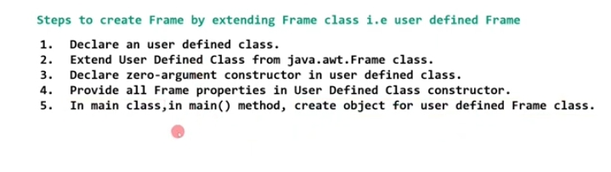

Slide 16
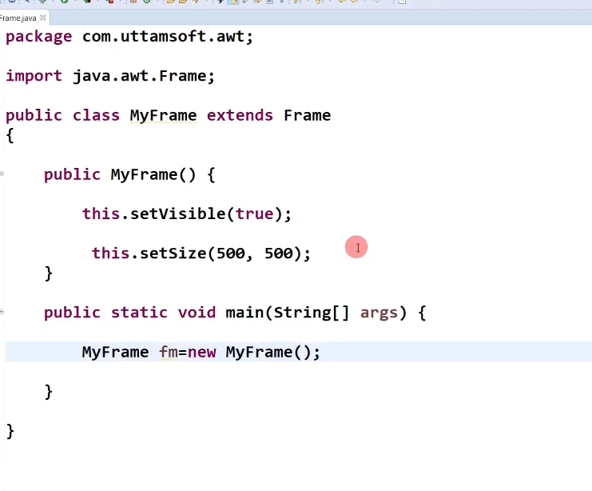

Slide 17
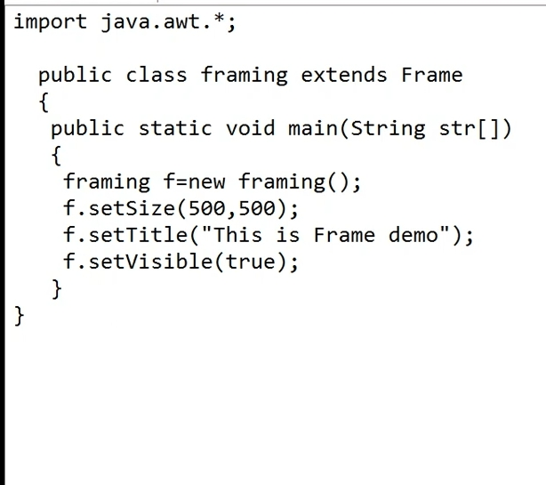

Slide 18
Creating windowed programs using applets
To create applet window, simply extend user defined class with library class java.applet.Applet.
For example,
class MyApplet extends Applet
{
public void init()
{
// declare and add component objects here
………………
………………
}
}

Slide 19
1.3. Use AWT Controls
Java AWT controls are the controls that are used to design graphical user interfaces or web applications.
To make an effective GUI, java provides java.awt package that supports various AWT controls.
AWT Controls place on Frame Window or Applet Window using add method.

Slide 20
The AWT supports the following types of controls:
Labels
Buttons
Check box
Check box group
Scroll bars
Text Field
Text Area

Slide 21
Labels :
Labels are simple components that are used to represent a single line read only text.
User can not change this text.
Syntax is,
Label(String s)
Label(String s, int style )
Methods :
void setText(String str)
String getText()
void setAllignment(int how)
int getAllignment()

Slide 22
2. Buttons :
A button is also called as push button.
Syntax is,
Button(String s)
The button class defines following two constructors.
Button()
Button(String str)
Methods :
void setLabel(String str)
String getLabel()

Slide 23
3. Check box :
Checkbox is basically small box which can be checked or not checked .
Syntax is,
Checkebox(String str)
Checkebox(String str, boolean state)
Checkebox(String str, boolean state, ChechboxGroup obj)
Methods :
void setLabel(String str)
String getLabel()
void setState(boolean state)
boolean getstate()

Slide 24
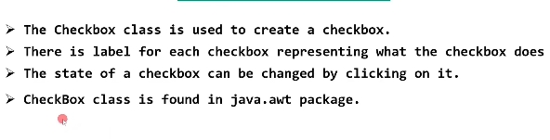

Slide 25
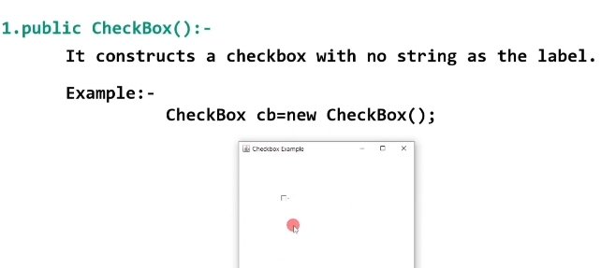

Slide 26
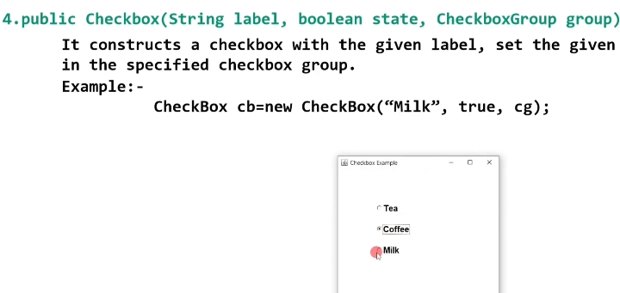

Slide 27
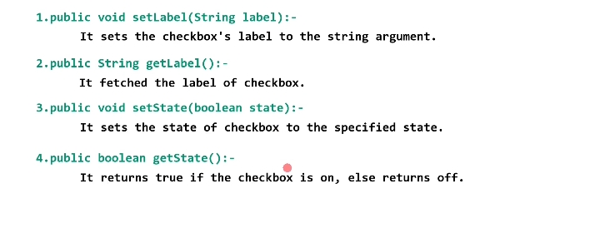

Slide 28
4. Check box group : Converts Checkbox in to radio button
Syntax is,
Checkbox(String str, CheckboxGroup cbg, Boolean val)
The Checkboxgroup class constructor -
CheckboxGroup()
Methods :
Checkbox getSelectedCheckbox()

Slide 29
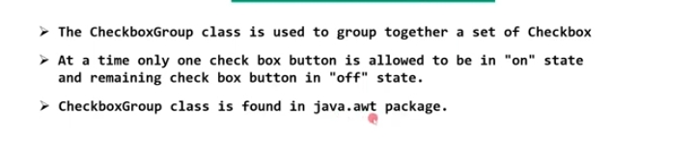

Slide 30
5. Scroll bars :
Scrollbar provides horizontal and vertical movement of a component or window.
Syntax is,
Scrollbar()
Scrollbar(int type) eg, Scrollbar(Scrollbar.VERTICAL)
Scrollbar(int type, int initial_value,
int thumb_size, int min_value, int max_value)

Slide 31
Methods of Scrollbar :
int getMinimum()
int getMaximum()
int getValue()
int setValue(int value)

Slide 32
6. Text Field :
A text field is single line textbox control, generally used to take input value from the user.
Syntax is,
TextField()
TextField(int max_char)
TextField(String str)
TextField(String str, int max_char)

Slide 33
Methods of TextField :
String getText()
String setText(String str)
String getSelectedText()
void select(int start_index, int end_index)
boolean isEditable()
void setEditable(boolean editable)
void setEchoChar(char ch)
boolean echoCharIsSet()
char getEchoChar()

Slide 34
7. Text Area :
TextArea is multiline Textfield
A TextArea is used to provide a paragraph or multiple lines as input.
Syntax is,
TextArea()
TextArea(int max_lines, int max_rows)
TextArea(String str)
TextArea(String str, int max_lines, int max_rows)
TextArea(String str, int max_lines, int max_rows, int scroll_type)

Slide 35
Methods of TextArea :
String getText()
String setText(String str)
String getSelectedText()
void select(int start_index, int end_index)
boolean isEditable()
void setEditable(boolean editable)
void append(String str)
void insert(String str, int index)
void replaceRange(String str, int start_index, int end_index)

Slide 36
8. Choice:
Choice class object provides a list of items.
Choice is used to create a pop-up list of items from which user may choose.
Syntax is,
Choice()

Slide 37
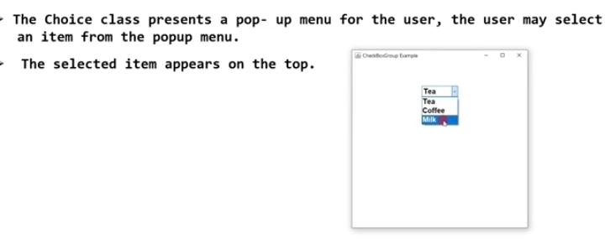

Slide 38
Methods of Choice :
void add(String name)
String getSelectedItem()
String getSelectedIndex()
int getItemCount()
Void select(int index)
String getItem(int index)

Slide 39
9. List :
List class object provides a list with multiple selection option and scrollbars.
A list control shows any numbers of items as choice in an open visible block.
Syntax is,
List()- Only one item at time
List(int visible_rows)- No of rows visible
List(int visible_rows, boolean multi_select)

Slide 40
Methods of List :
void add(String item)
void add(String item, int at_index)
String getSelectedItem()
String getSelectedIndex()
String[] getSlectedItems()
int [] getSlectedIndexes()
int getItemCount()
Void select(int index)-Select the item specified by index
String getItem(int index)

Slide 41
The AWT Controls:
Labels
Buttons
Check box
Check box group
Scroll bars
Text Field
Text Area
Choice
List

Slide 42
Useful Methods of Component class :
Methods | Description
public void add(Component c) | inserts a component on this component.
public void setSize(int width,int height) | sets the size (width and height) of the component.
public void setLayout(LayoutManager m) | defines the layout manager for the component.
public void setVisible(boolean status) | changes the visibility of the component, by default false.

Slide 43
Programs:
Write a program to create a login window form
Write a program to create student details form

Slide 44
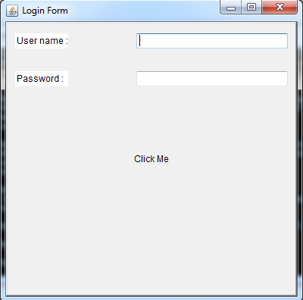
Output of program 1:

Slide 45
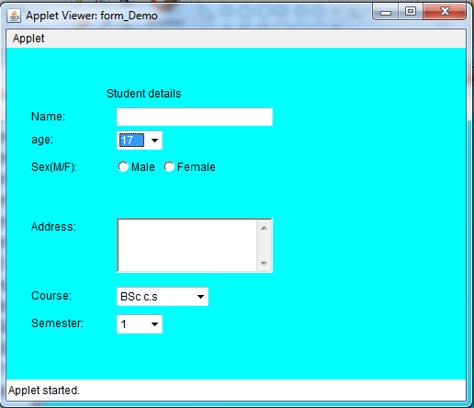
Output of program 2:

Slide 46
1.4. Layout Managers :
The LayoutManagers are used to arrange components in a particular manner.
LayoutManager is an interface which automatically arranges the controls on the screen.
Thus using layout manager the symmetric and systematic arrangement of the controls is possible.
Various LyoutManager are :
Flow Layout
Border Layout
Grid Layout
Card Layout
GridbagLayout

Slide 47
The layout manager is set by using setLayout() method, come under LayoutManager interface.
This method defined as,
void setLayout(LayoutManager obj)

Slide 48
Flow Layout :
Flow layout is the default layout manager.
Constructors of FlowLayout:
FlowLayout()
FlowLayout(int alignment)
FlowLayout(int alignment, int horizontal_gap, int vertical_gap)

Slide 49
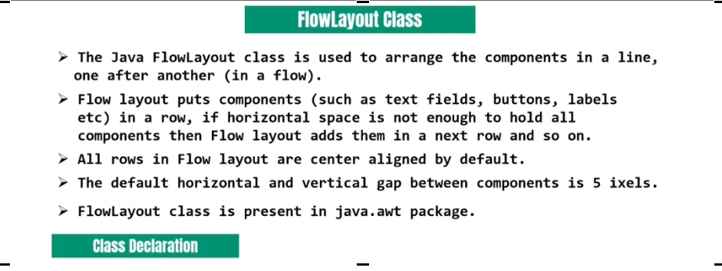

Slide 50
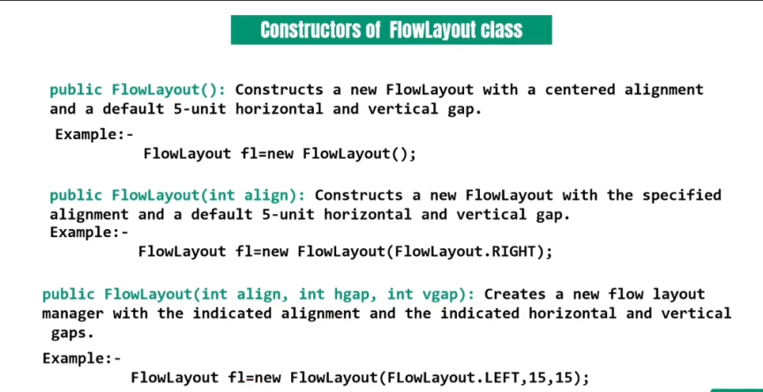

Slide 51
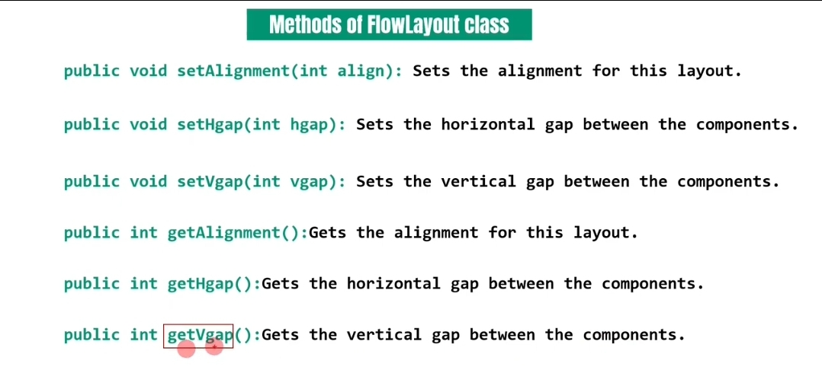

Slide 52
2. Border Layout :
BorderLayout is with four sides and one center area. Its sides referred as north, south, east, west. The middle area is called as center.
Constructors of BorderLayout:
BorderLayout()
BorderLayout(int horizontal_gap, int vertical_gap)
In BorderLayout the add() method is used to add components -
add(Component object, int region)

Slide 53
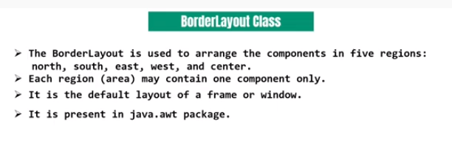

Slide 54
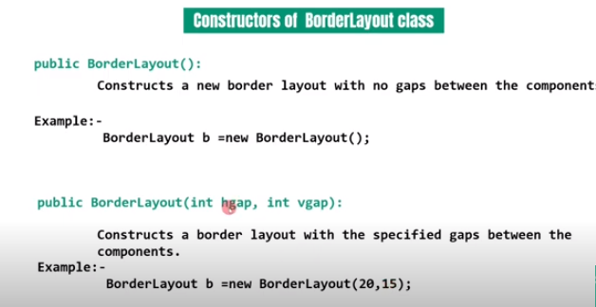

Slide 55
3. Grid Layout :
GridLayout position the components in two dimensional grids.
Constructors of GridLayout :
GridLayout()
GridLayout(int rows, int columns)
GridLayout(int rows, int columns, int horizontal_gap, int vertical_gap)

Slide 56
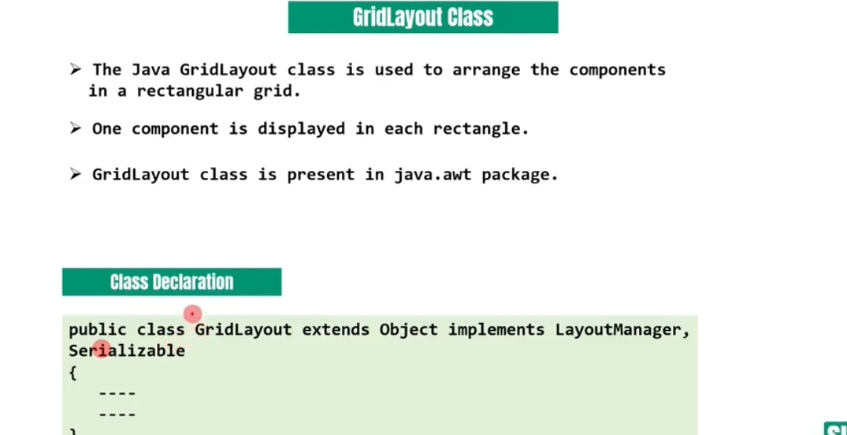

Slide 57
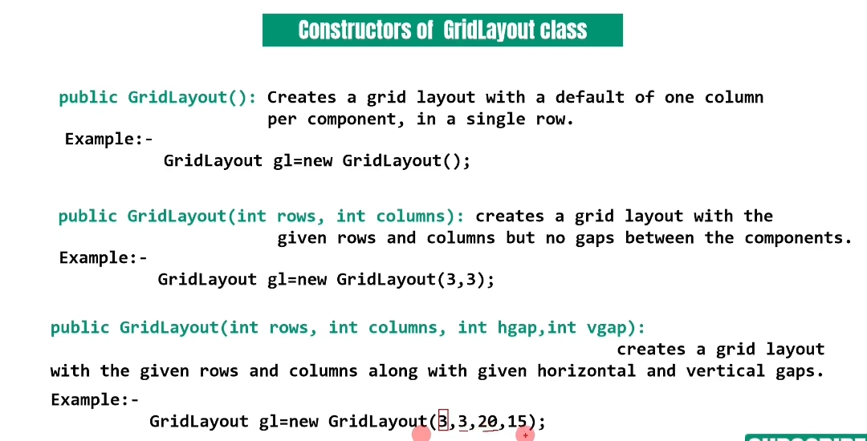

Slide 58
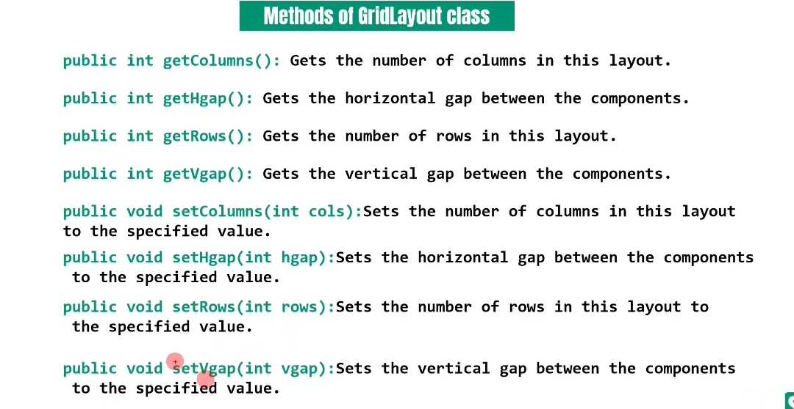

Slide 59
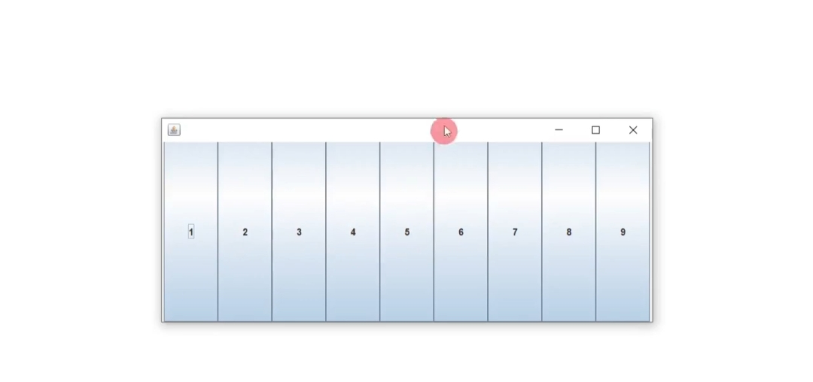

Slide 60
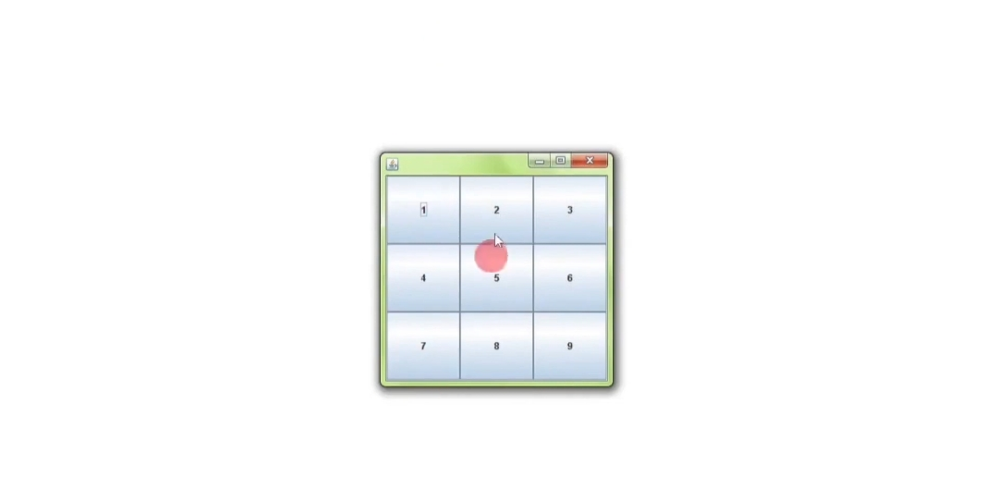

Slide 61
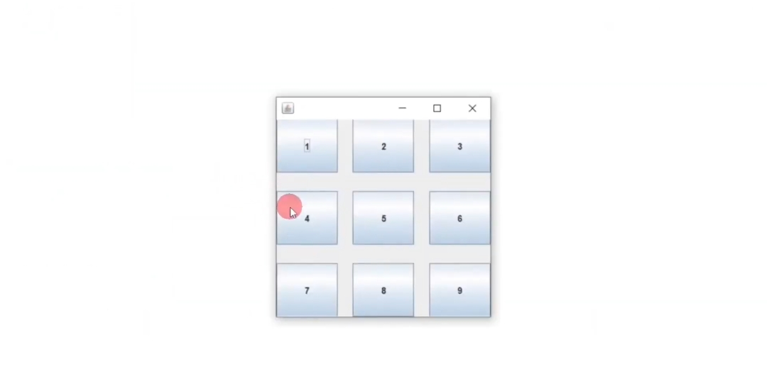

Slide 62
4. Card Layout :
The CardLayout manager allows us to have more than one layouts on the applet.
The CardLayout is conceptually thought a collection of cards laying on the panel.
Constructors of CardLayout :
CardLayout()
CardLayout(int horizontal_gap, int vertical_gap)
In CardLayout the add() method is used to add components -
add(Component object, panel obj)

Slide 63
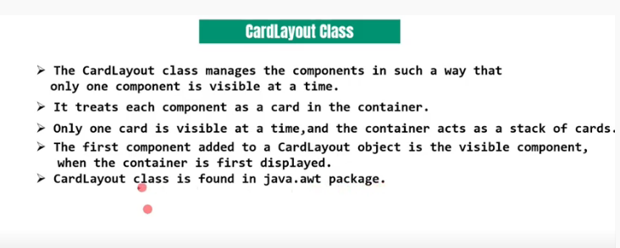

Slide 64
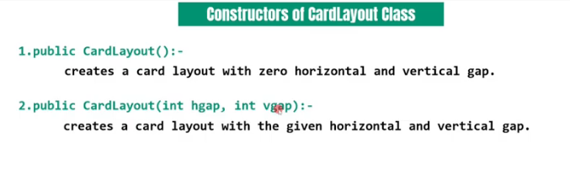

Slide 65
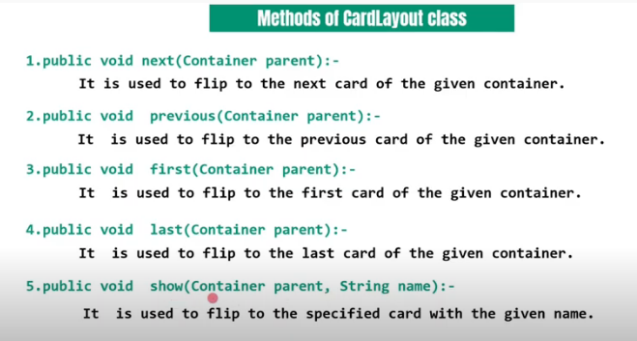

Slide 66
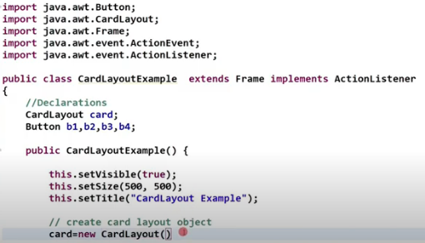

Slide 67
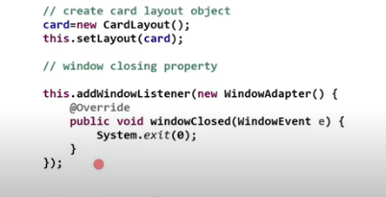

Slide 68
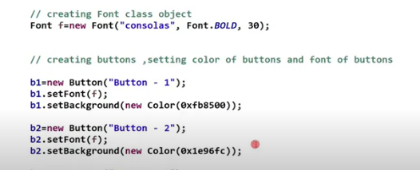

Slide 69
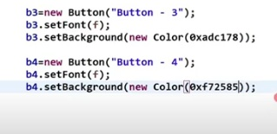

Slide 70
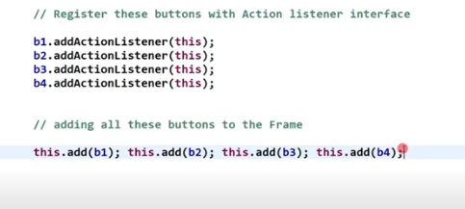

Slide 71
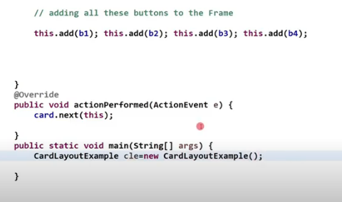

Slide 72
Methods of Card Layout which used for shifts between different decks:
void first(Container deck)
void last(Container deck)
void next(Container deck)
void previous(Container deck)
void show(Container deck)

Slide 73
5. GridbagLayout :
The GridbagLayout class is used to align components vertically, horizontally or along their baseline.
The components may not be the same size.
Each GridBagLayout obj maintain a dynamic and rectangular grid.
Each component occupies one or more cells.
It is the most flexible and complex layout manager.
The GridbagLayout manager places the components in rows and columns allowing the components to occupy multiple rows and columns. This is called display area.
java.awt.GridbagConstraints is used to arrange fill the components in bag of grids(cells).

Slide 74
GridBagConstraints parameter in the add() method.
Grid Position, width and height describes the display area using gridx, gridy, gridwidth and gridheight values.
Position within the display area using fill, ipadx and ipady.

Slide 75
The component can be added as :
add(component obj, GridBagConstraints obj)

Slide 76
1.5 Menu and MenuBar :
Menus are essential components of any window based GUI.
It allows user to choose one of the several options.
Menus are created with the help of Menu items and these menus are placed on menubar.
MenuItems can also replaced by objects of CheckboxMenuItem objects; which contains checkable menu-items. (For eg. Word Wrap option under Format Menu, in notepad)

Slide 77
The constructor of MenuBar –
MenuBar()
The Constructors of Menu –
Menu()
Menu(String menu_title)
Menu(String menu_title, boolean is_removable)

Slide 78
The Constructors of MenuItem –
MenuItem()
MenuItem(String item_title)
MenuItem(String item_title, MenuShortcut_key)
The Methods of MenuItem –
void setEnabled(boolean enable)
boolean isEnable()
void setLabel(String item_title)
String getLabel()

Slide 79
The Constructors of CheckboxMenuItem–
CheckboxMenuItem()
CheckboxMenuItem(String title)
CheckboxMenuItem(String title, boolean checked)
The Methods of CheckboxMenuItem –
void setState(boolean checked)
boolean getState()

Slide 80
1.6 Dialogbox :
Dialog control represents a top level window with a title and a border used to take some from of input from the user.
Dialog doesn't have minimum and maximum
For example,
class dialogboxdemo extends Frame
{
………………
………………
}

Slide 81
The Constructors of Dialog class –
Dialog(Frame parent_window_object, boolean visibility)
Dialog(Frame parent_window_object, String title, boolean visibility)
The Methods of Dialog class –
void setTitle(String title)
void setSize(int width, int height)
void setVisible(boolean visible)

Slide 82
1.6.1 File Dialog :
The file dialog class displays a dialog window from which the user can select a file.
Constructors of FileDialog :
FileDialog(Frame parent)
FileDialog(Frame parent, String title)
FileDialog(Frame parent, String title, int mode)

Slide 83
Methode of FileDialog :
String getFile()
int getMode()
void setDirectory(String dir)
void setMode(int mode)

Slide 84
Modal and Modeless Dialog window –
Modal Dialog Box :
A modal dialog box is one that the user must first close in order to have access to any other framed window or dialog box of the same application.
Modeless Dialog Box :
A dialog box is referred to as modeless if the user does not have to close in it order to continue using the application that owns the dialog box.

Slide 85
Thank you

